Slide 1

Introduction to Data Analytics
PROFESSIONAL CERTIFICATE IBM Data Analyst

Slide 2
Agenda
What is data analysis
Data analysis process
Data sources & structure
Modern data ecosystem
Data analysis primary types
Data professionals
A Day in the life of a data analyst
Data analyst required skills
Notes:
Our agenda today is:….. We have three main pillars to come out with today Modern data ecosystem, data analysis primary types, Rules and skills

Slide 3
What is Data Analysis
Data analysis helps businesses to
Understand their past performance and informs their decision-making for future actions
looking for patterns in financial transactions to detect fraud, using recommendation
Engines to drive conversion, mining, social media posts for customer voice or brands personalizing their offers based on customer behavior analysis, business leaders realized that data holds the key to competitive advantage.
Notes:
Data analysis is a process of inspecting, cleansing, transforming, and modeling data with the goal of discovering useful information, informing conclusions, and supporting decision-making.
This helps businesses understand past performance and inform their future decisions.

Slide 4
Data analysis process
Developing an understanding of the problem and the desired outcome.
Setting a clear metric for evaluating outcomes.
Gathering, cleaning, analyzing, and mining data to interpret results.
Communicating the findings in ways that impact decision-making.
Notes:
understanding the problem that needs to be solved, ensure that you are working on the right direction and know desired/expected outcome outcome
Setting a clear metric. This stage of the process includes deciding what will be measured.
gathering, cleaning, analyzing and mining data, interpreting
results, and reporting the findings
Story telling: communicating the results

Slide 5





Data Sources & Structure
HEALTH
BIOMETRICS
HOUSEHOLD DATA IN THE CASE OF IOT DEVICES
STRUCTURED
UNSTRUCTURED
Notes:
Data is diverse, banks, government organizations, political data….., any other suggestions???
Extract the data you need, ensure reliability integrity and security of the data
Structured data schema-dependent Excel, Google Sheets, SQL, Databases, Forms, customer data, phone records, transaction history
Unstructured Flexible; not schema-dependent
Text data, social media comments, phone calls transcriptions, various logs files, images, audio, video
-------------------------------------------------------------------------------------------------
There is also simi structured data: Email, XML and JSON, NoSQL
In short
We collect data and integrate data from disparate sources. Different types of analysis and skills are used to generate insights. Stakeholders collaborate and act on insights generated.
Ask participants about the GPS data, who is using is, how, and what service they are p[rovideing

Slide 6



Modern Data Ecosystem
Data
Enterprise Data Environment
End-users
Notes:
A modern data ecosystem includes a network of interconnected and continually evolving entities that include:
Data that is available in a host of different formats, structure, and sources.
Enterprise Data Environment in which raw data is staged so it can be organized, cleaned, and optimized for use by end-users.
End-users such as business stakeholders, analysts, and programmers who consume data for various purposes.
Emerging technologies such as Cloud Computing, Machine Learning, and Big Data, are continually reshaping the data ecosystem and the possibilities it offers. Data Engineers, Data Analysts, Data Scientists, Business Analysts, and Business Intelligence Analysts, all play a vital role in the ecosystem for deriving insights and business results from data.

Slide 7
Data Analyst Ecosystem
Gather Data
Clean Data
Mine Data
Visualize Data

Slide 8




Primary Types of Data Analysis
Descriptive Analytics helps answer questions about what happened over a given period
Diagnostic analytics helps answer the question. Why did it happen?
Predictive analytics helps answer the question, What will happen next?
Prescriptive Analytics helps answer the question, What should be done about it?
Notes:
Diagnostic analytics
: It takes the insights from descriptive analytics to dig deeper to find the cause of the outcome.
For example, a sudden change in traffic to a website without an obvious cause or an increase
in sales in a region where there has been no change in marketing.
3- risk assessment and sales forecasts.
4-airlines automatically adjusting ticket prices based on customer demand.
Gas prices, the weather or traffic on connecting routes.

Slide 9
Types of Data Analysis Activity
A company is interested in being able to forecast the weather using meteorological data and predicting the increase in water demand in a particular city or region. Predictive Analysis
An insurance company is interested in gathering more information on its customers such as their age, genders, and nationalities.

Slide 10
Types of Data Analysis Activity
Netflix wants to continue to recommend new shows/movies to their users (actionable predictions) using data gathered on their choices, purchases, or website navigation based on their clicks.
An unusually high number of people have been admitted to the ER over a short span of time at a local hospital.

Slide 11
Data professionals
Data engineers
Data analysts
Data scientists
Business analysts
Business intelligence or BI analysts

Slide 12
A Day in the Life of a Data Analyst
Acquiring
Preparing and analyzing
Interpreting
Ensuring
Acquiring data that best serves the use case.
Preparing and analyzing data to understand what it represents.
Interpreting and effectively communicating the message to stakeholders
Ensuring that the process is documented for future reference and repeatability.
Notes:
the role of a Data Analyst varies depending on the type of organization and the extent
to which it has adopted data-driven practices
The role of a Data Analyst spans across:
1,2,3,4
Who are the stakeholder: Stakeholders: who need to act on the findings.

Slide 13



Data Analyst Required Skills
Technical skills: spreadsheets, statistical tools, visualization tools, programming and querying languages, and the ability to work with different types of data repositories and big data platforms.
Functional skills: understanding of Statistics, Analytical techniques, problem-solving, the ability to probe a situation from multiple perspectives, data visualization, and project management skills
Soft Skills: include the ability to work collaboratively, communicate effectively, tell a compelling story with data, and garner support and buy-in from stakeholders. Curiosity to explore different pathways
Notes:
need a mix of technical, functional, and soft skills

Slide 14
A Day in the Life of a Data Analyst Activity
What do you think a day in the life of a Data Analyst would look like in the following roles?
Data analyst
Data Scientist
Data Engineer
Business Analyst
Fraud Analyst

Slide 15



Data Types
Structured
Semi-structured
Unstructured

Slide 16
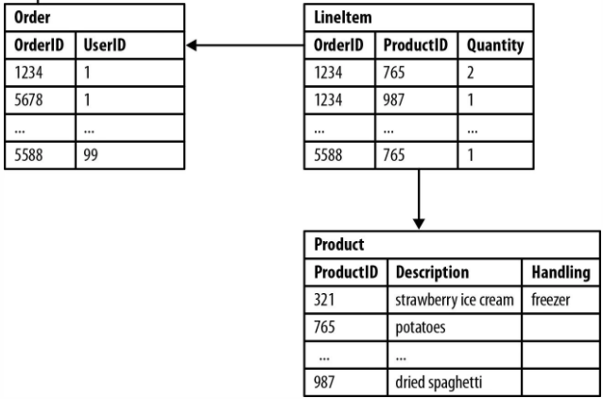
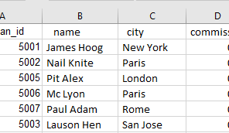
Structured
Data that follows a rigid format and can be organized neatly into rows and columns is structured data.
This is the data that you see typically in databases and spreadsheets, for example.
Dates
Phone numbers
ZIP codes
Customer names
Notes:
typically contains data types that are combined in a way to make them easy to search for in their data set.

Slide 17



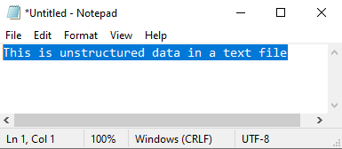
Unstructured Data
Complex, and mostly qualitative information that is impossible to reduce to rows and columns.

Slide 18

Semi-structured Data
Semi-structured data is a mix of data that has consistent characteristics and data that doesn’t conform to a rigid structure.
For example, emails.
An email has a mix of structured data, such as the name of the sender and recipient, but also has the contents of the email, which is unstructured data.

Slide 19
Sources of Data
Data sources have never been as dynamic and diverse as they are today
Relational Database
Non-Relational Database
APIs
Web Services
Data Streams
Social Platforms
Sensor Devices

Slide 20
Data Repositories: Breakout Room Activity 10 min
A data repository is a general term used to refer to data that has been collected, organized, and isolated so that it can be used for business operations or mined for reporting and data analysis.
Databases
Data warehouses
Data marts
Data lakes
Big data stores.
Notes:
The type, format, and sources of data influence the type of data repositories that you can
use to collect, store, clean, analyze, and mine the data for analysis.

Slide 21
Big Data Processing Tools
The Big Data processing technologies provide ways to work with large sets of structured, semi-structured, and unstructured data so that value can be derived from big data.
Apache Hadoop
Apache Hive
Apache Spark

Slide 22
Any questions

